Slide 1
Java Package API and Inheritance

Slide 2
Java Packages & API
A package in Java is used to group related classes. Think of it as a folder in a file directory.
We use packages to avoid name conflicts, and to write a better maintainable code. Packages are divided into two categories:
Built-in Packages (packages from the Java API)
User-defined Packages (create your own packages)

Slide 3
Built-in Packages
The Java API is a library of prewritten classes, that are free to use, included in the Java Development Environment.
The library contains components for managing input, database programming, and much much more.
The complete list can be found at Oracles website: https://docs.oracle.com/javase/8/docs/api/.
The library is divided into packages and classes. Meaning you can either import a single class (along with its methods and attributes), or a whole package that contain all the classes that belong to the specified package.
To use a class or a package from the library, you need to use the import keyword

Slide 4
Package Import

Slide 5
Java Inheritance (Subclass and Superclass)
In Java, it is possible to inherit attributes and methods from one class to another. We group the "inheritance concept" into two categories:
subclass (child) - the class that inherits from another class
superclass (parent) - the class being inherited from
To inherit from a class, use the extends keyword

Slide 6
Why use inheritance in java
For Method Overriding (so runtime polymorphism can be achieved).
For Code Reusability.

Slide 7
The syntax of Java Inheritance
class Subclass-name extends Superclass-name {
//methods and fields
}
The extends keyword indicates that you are making a new class that derives from an existing class.
The meaning of "extends" is to increase the functionality.

Slide 8
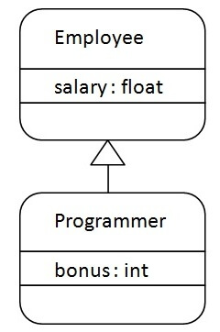
Java Inheritance Example

Slide 9
Types of inheritance in java
On the basis of class, there can be three types of inheritance in java: single, multilevel and hierarchical.
In java programming, multiple and hybrid inheritance is supported through interface only.

Slide 10
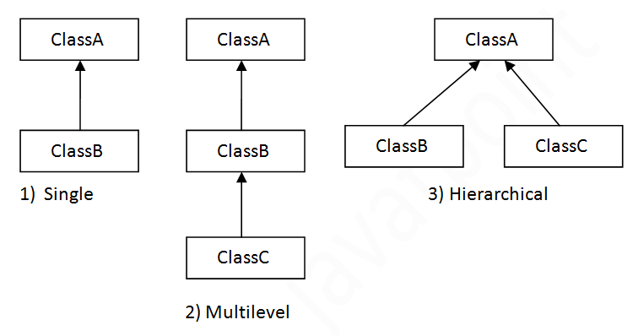

Slide 11
When one class inherits multiple classes, it is known as
multiple inheritance.

Slide 12
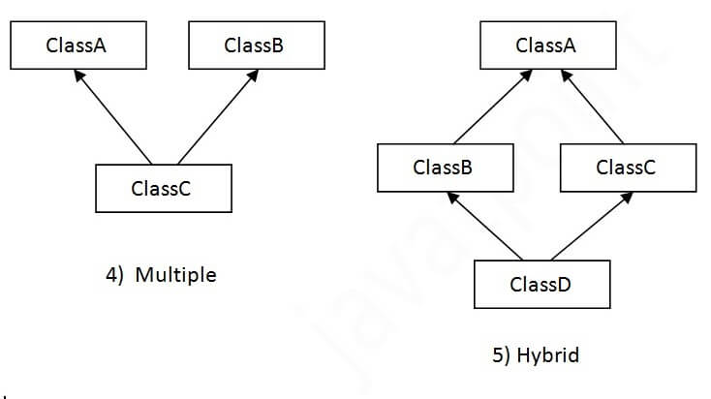

Slide 13
Why multiple inheritance is not supported in java?
To reduce the complexity and simplify the language, multiple inheritance is not supported in java.Consider a scenario where A, B, and C are three classes. The C class inherits A and B classes. If A and B classes have the same method and you call it from child class object, there will be ambiguity to call the method of A or B class.
Since compile-time errors are better than runtime errors, Java renders compile-time error if you inherit 2 classes. So whether you have same method or different, there will be compile time error.

